Slide 1

LINEAR PROGRAMMING
SCHOOL OF DATA SCIENCE AND FORECASTING
DEVI AHILYA VISHWAVIDYALAYA, INDORE

Slide 2
LINEAR PROGRAMMING
Linear programming, Linear Optimization, is a mathematical method that is used to determine the best possible outcome or solution from a given set of parameters or list of requirements, which are represented in the form of linear relationships.
Linear programming model - A mathematical model with a linear objective function, a set of linear constraints, and nonnegative variables. Linearity implies that Linear Programming must satisfy two properties:
Proportionality-It requires the contribution of each decision variable in the objective function and its requirements in the constraints should be directly proportional to the value of the variable.
Additivity-It requires that terms of the objective function and constraints be additive i.e. total profit must be equal to the sum of profits from decision variable, total requirements of resources must be equal to the sum of the resources required by each decision variable.

Slide 3
Applications:
Product Mix Problems
Diet Problems
Portfolio Selection
Transportation Problems
Assignments Problems
Project Management Problems
Marketing Research Problems, etc.

Slide 4
Linear Programming Problem Formulation
Problem Formulation - The process of translating the verbal statement of a problem into a mathematical statement called the mathematical model.
Steps of LPP Formulation:
Define the decisions variables
Determine the objective function
Develop the mathematical relationship of the constraints
Establish non-negativity restrictions.

Slide 5
Problem Formulation-Examples
Example-1: Product Mix
A company manufactures two products A and B. Per unit profit from product A is Rs. 4 and from product B is Rs. 3. A and B take 3 and 2 minutes respectively on machine. The total time available at machining department is 800 hours. A market research showed that at least 10000 units of A and not more than 6000 units of B are needed. It is required to determine the number of units of A and B to be produced to maximize profit.

Slide 6
Problem Formulation (Example-1)
Decision Variables:
X₁ = No. of units of Product A to be produced
X₂ = No. of units of Product B to be produced
Objective Function:
Maximize Z= 4X₁ + 3X₂
Constraints:
3X₁ + 2X₂ ≤ 800x60
X₁ ≥ 10000
X₂ ≤ 6000
Non-Negativity Conditions:
X_{1,} X₂ ≥ 0

Slide 7
Problem Formulation-Examples
Example-2: Feed Mix
A farmer is interested in feeding his cattle at minimum cost. Two feeds are used A and B. Each cow must get at least 400 grams/day of protein, at least 800 grams/day of carbohydrates, and not more than 100 grams/day of fat. Given that A contains 10% protein, 80% carbohydrates and 10% fat while B contains 40% protein, 60% carbohydrates and no fat.
A costs Rs. 2 /kg, and B costs Rs. 5 /kg.
Formulate the problem to determine the optimum amount of each feed at minimize total cost.

Slide 8
Problem Formulation (Example-2)
Decision Variables:
X₁ = Amount of Feed A kg./day
X₂ = Amount of Feed B kg./day
Objective Function:
Minimize Z= 2X₁ + 5X₂
Constraints:
Protein 0.1X₁ + 0.4X₂ ≥ 0.40 or X₁ + 4X₂ ≥ 4
Carbohydrates 0.8X₁ + 0.6X₂ ≥ 0.80 or 8X₁ + 6X₂ ≥ 8
Fat 0.1X₁ ≤ 0.10 or X₁ ≤ 1
Non-Negativity Conditions:
X_{1,} X₂ ≥ 0

Slide 9
Problem Formulation-Examples
Example-3: Blending
An iron ore from 4 mines will be blended. The analysis has shown that, in order to obtain suitable tensile properties, minimum requirements must be met for 3 basic elements A, B, and C. Each of the 4 mines contains different amounts of the 3 elements (table below). Formulate the problem to find the least cost blending for one ton of iron ore.
Basic Elements | Minimum Requirement (Kg./Ton) | Composition from the mine Kg./ Ton
 |  | 1 | 2 | 3 | 4
A | 5 | 10 | 3 | 8 | 2
B | 10 | 90 | 150 | 75 | 175
C | 30 | 45 | 25 | 20 | 37
Cost of Ore from mine (Rs. / Ton) |  | 800 | 400 | 600 | 500

Slide 10
Problem Formulation (Example-3)
Decision Variables:
X₁ = Amount of Ore from Mine-1 (Ton)
X₂ = Amount of Ore from Mine-2(Ton)
X₃ = Amount of Ore from Mine-3 (Ton)
X₄ = Amount of Ore from Mine-4 (Ton)
Objective Function:
Minimize Z= 800X₁ + 400X₂ + 600X₃ + 500X₄
Constraints:
Total Ore X₁ + X₂ + X₃ + X₄ = 1
A 10X₁ + 3X₂ + 8X₃ + 2X₄ ≥ 5
B 90X₁ + 150X₂ + 75X₃ + 175X₄ ≥ 10
C 45X₁ + 25X₂ + 20X₃ + 37X₄ ≥ 30
Non-Negativity Conditions:
X_{1,} X_{2,} X_{3,} X₄ ≥ 0

Slide 11
Problem Formulation-Examples
Example-4: Product Mix
A company manufactures two kinds of machines, each requires a different manufacturing technique. The deluxe machine requires 18 hours of labour, 9 hours of testing, and yields a profit of Rs. 400. The standard machine requires 3 hours of labour, 4 hours of testing, and yields a profit of Rs. 200. There are 800 hours of labour and 600 hours of testing available each month. A marketing forecast has shown that the monthly demand for the standard machine to be no more than 150. Management wants to know the number of each machine to produce monthly that will maximize total profit. Formulate this as a linear programming problem.

Slide 12
Problem Formulation (Example-4)
Decision Variables:
X₁ = Number of Deluxe Machines to be produced
X₂ = Number of Standard Machines to be produced
Objective Function:
Maximize Z= 400X₁ + 200X₂
Constraints:
Labour 18X₁ + 3X₂ ≤ 800
Testing 9X₁ + 4X₂ ≤ 600
Market Demand X₂ ≤ 150
Non-Negativity Conditions:
X_{1,} X₂ ≥ 0

Slide 13
Problem Formulation-Examples
Example-5: Optimal Assignment
A company has 2 grades of inspectors I and II. It is required that at least 1800 pieces be inspected per 8 hour day. Grade-I inspectors can check pieces at the rate of 25 per hour with an accuracy of 98%. Grade-II inspectors can check at the rate of 15 pieces per hour with an accuracy of 95%. Grade-I costs Rs. 4 per hour, grade-II costs Rs. 3 per hour. Each time an error is made by an inspector costs the company Rs. 2. There are 8 grade-I and 10 grade-II inspectors available. The company wants to determine the optimal assignment of inspectors which will minimize the total cost of inspection/day.

Slide 14
Problem Formulation (Example-5)
Decision Variables:
X₁ = Number of Grade-I inspectors to be assigned the job
X₂ = Number of Grade-II inspectors to be assigned the job
Objective Function:
The cost of Grade-I inspector per hour = Rs. (4+0.02*25*2)=Rs. 5
The cost of Grade-II inspector per hour = Rs. (3+0.05*15*2)=Rs. 4.5
Minimize Z= 8*(5X₁ + 4.5X₂) = 40X₁ + 36X₂
Constraints:
No. of Grade-I Inspectors X₁ ≤ 8
No. of Grade-II Inspectors X₂ ≤ 10
Total Inspection Task (in 8 hours) 8*25X₁ + 8*15X₂ ≥ 1800
or 5X₁ + 3X₂ ≥ 45
Non-Negativity Conditions:
X_{1,} X₂ ≥ 0

Slide 15
General Form of LP Models:
Objective Function:
Constraints:
Maximize Z= Σ^{n}_{j=1} C_{j}X_{j}
Σ^{n}_{j=1} a_{ij}X_{i} ≤ b_{i} X_{i} ≥ 0 i = 1, …., m j = 1, …., n
Where
n = Number of activities.
X_{j} = Level of activity j
C_{j} =Contribution of activity j (per unit) in the objective function
m = Number of resources
B_{i} = Amount of resource i available.
a_{ij}=Amount of resource i consumed by one unit of activity j
Other forms
1. Minimize Z= Σ^{n}_{j=1} C_{j}X_{j} 2. Σ^{n}_{j=1} a_{ij}X_{i} ≥ b_{i}
3. Σ^{n}_{j=1} a_{ij}X_{i} = b_{i}
4. X_{i} unrestricted in sign for some values of i

Slide 16
GRAPHICAL LP SOLUTION METHOD:
Graphical Solution Method is used to solve LP problems that involve two decision variables.
Steps:
Plot all constraints
Determine the feasible region satisfying all constraints
Determine the optimal solution
Feasible Solution: It satisfies all constraints.
Optimal Solution: It is a feasible solution that has the most favorable value of the objective function (largest for maximize or smallest for minimize).

Slide 17
Graphical Solution-Examples
Example-1: Interior and Exterior Paints (Product Mix)
Reddy Mikks produces both interior and exterior paints from two raw materials, M1 & M2. The following table provides the basic data of the problem:
A market survey indicates that the daily demand for interior paint cannot exceed that of exterior paint by more than 1 ton. Also, the maximum daily demand of interior paint is 2 tons. Reddy Mikks wants to determine the optimum (best) product mix of interior and exterior paints that maximizes the total daily profit.
 | Tons of raw material per ton of |  | Maximum daily availability (Tons)
 | Exterior Paint | Interior Paint
Raw Material M1 | 6 | 4 | 24
Raw Material M2 | 1 | 2 | 6
Profit per Ton (Rs., 000) | 5 | 4

Slide 18
Graphical Solution-Example-1
Decision Variables:
X₁ = Daily Production of Exterior Paint (Ton)
X₂ = Daily Production of Interior Paint (Ton)
Objective Function:
Maximize Z= 5X₁ + 4X₂
Constraints:
Raw Material M1 6X₁ + 4X₂ ≤ 24 ….…..(1)
Raw Material M2 X₁ + 2X₂ ≤ 6…….…..(2)
Market Demand -X₁ + X₂ ≤ 1 ……….…(3)
Market Demand X₂ ≤ 2 ………….(4)
Non-Negativity Conditions:
X_{1,} X₂ ≥ 0 …………………….. (5, 6)

Slide 19
Graphical Solution-Example-1
Plot of Constraints:
X_{1,} X₂ ≥ 0 Both variables are ≥ 0, restrict to First quadrant only.
6X₁ + 4X₂ ≤ 24…… (1) Plot the Line 6X₁ + 4X₂ = 24 and trace the region satisfying ≤ criterion | X₁ + 2X₂ ≤ 6…… (2) Plot the Line X₁ + 2X₂ = 6 and trace the region satisfying ≤ criterion
-X₁ + X₂ ≤ 1.…… (3) Plot the Line -X₁ + X₂ = 1 and trace the region satisfying ≤ criterion | X₂ ≤ 2.…… (4) Plot the Line X₂ = 2 and trace the region satisfying ≤ criterion
Variable | Value
X₁ | 0 | 4
X₂ | 6 | 0
Variable | Value
X₁ | 0 | 6
X₂ | 3 | 0
Variable | Value
X₁ | All Values
X₂ | 2
Variable | Value
X₁ | 0 | -1
X₂ | 1 | 0

Slide 20
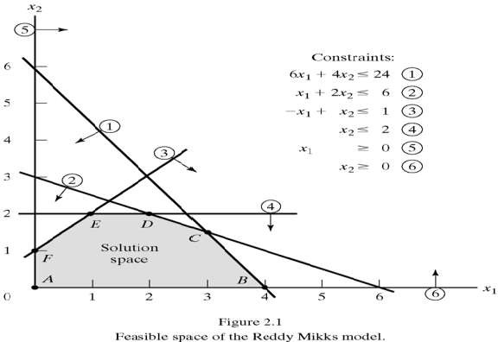
Graphical Solution-Example-1
ABCDEF consists of an infinite number of points.
We need a systematic procedure that identifies the optimum solution.
The optimum solution is associated with a corner point of the solution space.

Slide 21
Graphical Solution-Example-1
Objective Function Approach:
Plot the objective function with different values of z. Parallel will be drawn. Continue to plot the parallel z lines with increasing (in case of Maximization) or decreasing (in case of Minimization) values of z till the z line reaches a corner point of feasible solution space in that direction. Further increase / decrease in z value, the z line will cross the feasible solution space.
Last corner point in the feasible solution space is Optimum Point and associated z value is the Optimum z value.
Extreme Corner Point Approach:
Determine coordinates of all corner points of the feasible solution space.
Determine z value at each corner point
The Point that gives maximum z value (in case of Maximization) or minimum z value (in case of Minimization) is the Optimum Point and associated z value is the Optimum z value.

Slide 22
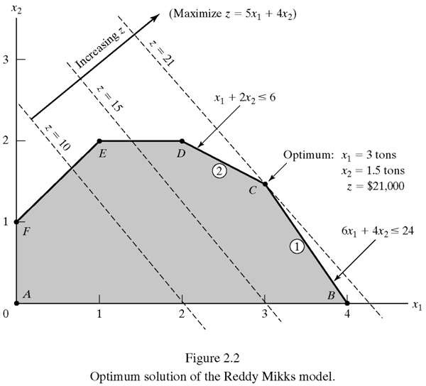
Graphical Solution-Objective Function Approach
To determine the direction in which the objective function increases we assign arbitrary increasing values to z, say 10 and 15
5 X₁ + 4 X₂=10
5 X₁ + 4 X₂=15
The optimum solution is mixture of 3 tons of exterior paint and 1.5 tons of interior paint and that will yield a daily profit of Rs. 21,000.

Slide 23
Graphical Solution-Extreme Corner Point Approach
Corner Point | Coordinates of Corner Point (X₁, X₂) | Z value
A | 0,0 | 0
B | 4,0 | 20
C | 3,1.5 | 21
D | 2,2 | 18
E | 1,2 | 13
F | 0,1 | 4
Maximize Z= 5X₁ + 4X₂
The optimum solution is mixture of 3 tons of exterior paint and 1.5 tons of interior paint and that will yield a daily profit of Rs. 21,000.

Slide 24
Graphical Solution-Examples
Example-2: Diet Problem
ABC Farms uses at least 800 kg. of special feed daily. The special feed is a mixture of corn and soybean meal with the following compositions:
The dietary requirements of the special feed are at least 30% protein and at most 5% fiber. ABC Farms wishes to determine the daily minimum cost feed mix.
Feedstuff | Kg. per kg. of Feedstuff |  | Cost (Rs./Kg.)
 | Protein | Fiber
Corn | 0.09 | 0.02 | 0.30
Soybean meal | 0.60 | 0.06 | 0.90

Slide 25
Graphical Solution-Example-2
Decision Variables:
X₁ = Corn in daily mix (Kg.)
X₂ = Soybean meal in the daily mix (Kg.)
Objective Function:
Minimize Z= 0.3X₁ + 0.9X₂
Constraints:
Demand X₁ + X₂ ≥ 800 …………………..…..(1)
Protein Requirement 0.09X₁ + 0.6X₂ ≥ 0.3 (X₁ + X₂)
or 0.21X₁ – 0.3 X₂ ≤ 0 ………………….(2)
Fiber Requirement 0.02X₁ + 0.06X₂ ≤ 0.05 (X₁ + X₂)
or 0.03X₁ – 0.01X₂ ≥ 0 ……………. …(3)
Non-Negativity Conditions:
X_{1,} X₂ ≥ 0 …………………….. (4, 5)

Slide 26
Graphical Solution-Example-2
Plot of Constraints:
X₁ + X₂ ≥ 800…… (1) Plot the Line X₁ + X₂ = 800 and trace the region satisfying ≥ criterion | 0.21X₁ – 0.3X₂ ≤ 0…… (2) Plot the Line 0.21X₁ – 0.3X₂ = 0 and trace the region satisfying ≤ criterion
0.03X₁ – 0.01X₂ ≥ 0.…… (3) Plot the Line 0.03X₁ – 0.01X₂ = 0 and trace the region satisfying ≥ criterion | X_{1,} X₂ ≥ 0 Both variables are ≥ 0, restrict to First quadrant only.
Variable | Value
X₁ | 0 | 800
X₂ | 800 | 0
Variable | Value
X₁ | 0 | 100
X₂ | 0 | 70
Variable | Value
X₁ | 0 | 100
X₂ | 0 | 300

Slide 27
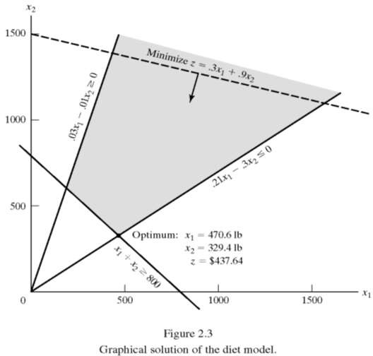
Graphical Solution-Example-2
Problem is Minimization
Target Points are A & B
Corner Point | Coordinates of Corner Point (X₁, X₂) | Z value
A | 470.6,329.4 | 437.64
B | 200,600 | 600
B
A

Slide 28
SIMPLEX METHOD:
LPP into Standard Format:
Convert all constraints (with the exception of non-negativity restrictions) into equations with a non-negative right hand side.
All variables are non-negative.
Converting Inequalities into Equations:
To convert a ≤ type inequality into equation, add non-negative slack variable to the LHS of the constraint. Slack variable represents unused amount of the resource.
6X₁ + 4X₂ ≤ 24 converts to 6X₁ + 4X₂ + S₁ = 24
S₁ is slack variable.
To convert a ≥ type inequality into equation, subtract a non-negative surplus variable from the LHS of the constraint. Surplus variable represents overused amount of the resource.
X₁ + X₂ ≥ 800 converts to X₁ + X₂ – S₂ = 800
S₂ is surplus variable.

Slide 29
SIMPLEX METHOD:
Nonnegative RHS:
If any constraint is having negative right hand side multiply both side by -1
-X₁ + X₂ ≥ -15 or -X₁ + X₂ - S₁ = -15 or X₁ - X₂ + S₁ = 15
or X₁ - X₂ ≤ 15 or X₁ - X₂ + S₁ = 15
All Variables Nonnegative:
If any variable is unrestricted or negative, replace it in all equations (including z equation) by the difference of two nonnegative variables.
If X₁ is negative or unrestricted then put X₁ = X'₁ - X''₁ in all equations (including z-equation). Both X'_{1,} X''₁ ≥ 0

Slide 30
SIMPLEX METHOD:
Example:
Minimize Z= 800X₁ + 400X₂ + 600X₃ + 500X₄
Subject to
X₁ + X₂ + X₃ + X₄ = 1
10X₁ + 3X₂ + 8X₃ + 2X₄ ≥ - 5
90X₁ + 150X₂ + 75X₃ + 175X₄ ≤ 10
45X₁ + 25X₂ + 20X₃ + 37X₄ ≥ 30
X_{1,}X_{3,}X₄ ≥ 0 and X₂ is unrestricted.

Slide 31
SIMPLEX METHOD:
Standard Form:
Minimize Z= 800X₁ + 400(X'₂ -X''₂) + 600X₃ + 500X₄
Subject to
X₁ + X'₂ -X''₂ + X₃ + X₄ = 1
-10X₁ - 3(X'₂ -X''₂) - 8X₃ - 2X₄ ≤ 5 -10X₁-3(X'₂ -X''₂) - 8X₃-2X₄+S₁ = 5
90X₁ + 150(X'₂ -X''₂) + 75X₃ + 175X₄ + S₂ = 10
45X₁ + 25(X'₂ -X''₂) + 20X₃ + 37X₄ – S₃ = 30
X_{1,} X'_{2,} X''_{2 ,} X_{3,}X_{4,} S_{1,}S_{2,} S₃ ≥ 0

Slide 32
SIMPLEX METHOD:
The standard LP form includes m simultaneous linear equations in n unknowns or variables (m<n).
Starting Basic Solution:
Put n-m number of variables equal to zero.
The variable which are assigned zero values are called non-basic variables.
Remaining m variables whose values are determined by solving the resulting m equations are called basic variables.
The resulting solution is Basic Solution(BS). If all values are satisfying non- negativity then resulting BS is Feasible Basic Solution(BFS), otherwise, it is infeasible.
The maximum number of possible basic solution for m equations in n variables is
n! m!(n − m)!

Slide 33
SIMPLEX METHOD:
Steps of the Simplex Method:
Determine a starting basic feasible solution
Select an entering variable using the optimality condition. Stop if there is no entering variable; last solution optimal.
Select a leaving variable using the feasibility condition.
Determine the new basic solution by using the appropriate Gauss- Jordan computations. Go to Step 2.

Slide 34
Optimality Condition:
The entering variable in maximization (minimization) problem is the non-basic variable having the most negative (positive) coefficient in the Z- row. The optimum is reached at the iteration where Z-row coefficients of all non-basic variables are non-negative (non-positive). Ties are broken arbitrarily.
Feasibility Condition:
For both the maximization and minimization problems the leaving variable is the basic variable associated with the smallest non-negative ratio (obtained by dividing the solution column with the entering column with strictly positive denominator). Ties are broken arbitrarily.

Slide 35
Pivot Column, Row, and Element:
The column associated with the Entering Variable is known as Pivot (Entering) Column.
The row associated with the leaving variable is known as Pivot row.
The element at the intersection of Pivot Column and Pivot Row is Pivot Element.
Gauss-Jordan Computations:
1. Pivot Row:
New Pivot Row = Current Pivot Row / Pivot Element
2. All Other Rows (including z-row):
New Row = Current Row – (its Pivot Column Coefficient) x New Pivot Row

Slide 36
SIMPLEX METHOD:
Reddy Mikks Model (Production of Exterior and Interior Paints)
X₁ = Daily Production of Exterior Paint (Ton)
X₂ = Daily Production of Interior Paint (Ton)
Objective Function:
Maximize Z= 5X₁ + 4X₂
Constraints:
Raw Material M1 6X₁ + 4X₂ ≤ 24 ….…..(1)
Raw Material M2 X₁ + 2X₂ ≤ 6…….…..(2)
Market Demand -X₁ + X₂ ≤ 1 ……….…(3)
Market Demand X₂ ≤ 2 ………….(4)
Non-Negativity Conditions:
X_{1,} X₂ ≥ 0 …………………….. (5, 6)

Slide 37
SIMPLEX METHOD:
Standard Form:
Maximize Z - 5X₁ - 4X₂ = 0
Subject to,
Raw Material M1 6X₁ + 4X₂ + X₃ = 24 ….…..(1)
Raw Material M2 X₁ + 2X₂ + X₄ = 6…….…..(2)
Market Demand -X₁ + X₂ + X₅ = 1 ……….…(3)
Market Demand X₂ + X₆ = 2 ………….(4)
Non-Negativity Conditions:
X_{1,} X_{2,}X_{3,}X_{4,}X_{5,}X₆ ≥ 0

Slide 38
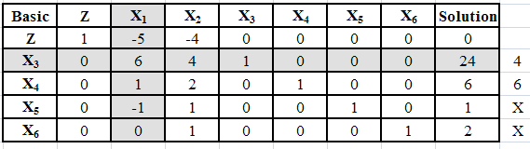
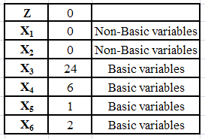
SIMPLEX METHOD:
Pivot Row
The Starting Basic Feasible Solution
Pivot Row
Pivot Column
Pivot Element
Ratio

Slide 39
New Pivot Row:
New Z Row:
Basic | Z | X₁ | X₂ | X₃ | X₄ | X₅ | X₆ | Solution
X₃ | 0 | 6 | 4 | 1 | 0 | 0 | 0 | 24
X1 | 0 | 1 | 2/3 | 1/6 | 0 | 0 | 0 | 4
Current Pivot Row
New Pivot Row
Basic | Z | X₁ | X₂ | X₃ | X₄ | X₅ | X₆ | Solution
Z | 1 | -5 | -4 | 0 | 0 | 0 | 0 | 0
X1 | 0 | 1 | 2/3 | 1/6 | 0 | 0 | 0 | 4
Z | 1 | 0 | -2/3 | 5/6 | 0 | 0 | 0 | 20
Current Z Row
x(+5)
New Z Row

Slide 40
Iteration-1
Iteration-2 (Optimum)
Basic | Z | X₁ | X₂ | X₃ | X₄ | X₅ | X₆ | Solution
Z | 1 | 0 | -2/3 | 5/6 | 0 | 0 | 0 | 20
X1 | 0 | 1 | 2/3 | 1/6 | 0 | 0 | 0 | 4
X₄ | 0 | 0 | 4/3 | -1/6 | 1 | 0 | 0 | 2
X₅ | 0 | 0 | 5/3 | 1/6 | 0 | 1 | 0 | 5
X₆ | 0 | 0 | 1 | 0 | 0 | 0 | 1 | 2
Ratio
-
6
3/2
3
2
Basic | Z | X₁ | X₂ | X₃ | X₄ | X₅ | X₆ | Solution
Z | 1 | 0 | 0 | ¾ | ½ | 0 | 0 | 21
X1 | 0 | 1 | 0 | 1/4 | -1/2 | 0 | 0 | 3
X₂ | 0 | 0 | 1 | -1/8 | 3/4 | 0 | 0 | 3/2
X₅ | 0 | 0 | 0 | 3/8 | -5/4 | 1 | 0 | 5/2
X₆ | 0 | 0 | 0 | 1/8 | -3/4 | 0 | 1 | 1/2
Coefficients of all non-basic variables in z-row are non-negative. Therefore, current solution is optimum.
Decision Variable | Optimal Value | Recommendation
X₁ | 3 | Produce 3 Tons of Exterior Paint Daily
X₂ | 3/2 | Produce 1.5 Tons of Interior Paint Daily
Z | 21 | Daily Profit = Rs. 21,000

Slide 41
Thank You!
Dr. V.B.Gupta
+ 91 99933 50547
vbgupta.davv@gmail.com

